Slide 1
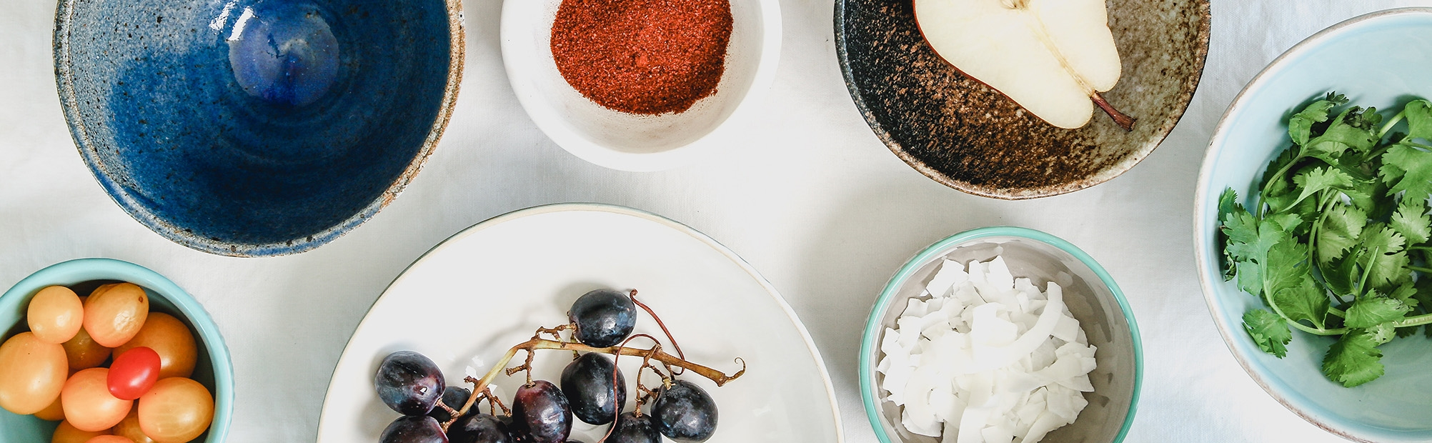
KITCHEN STOCK MANAGEMENT
JAYARUWAN PARD
E2046035

Slide 2
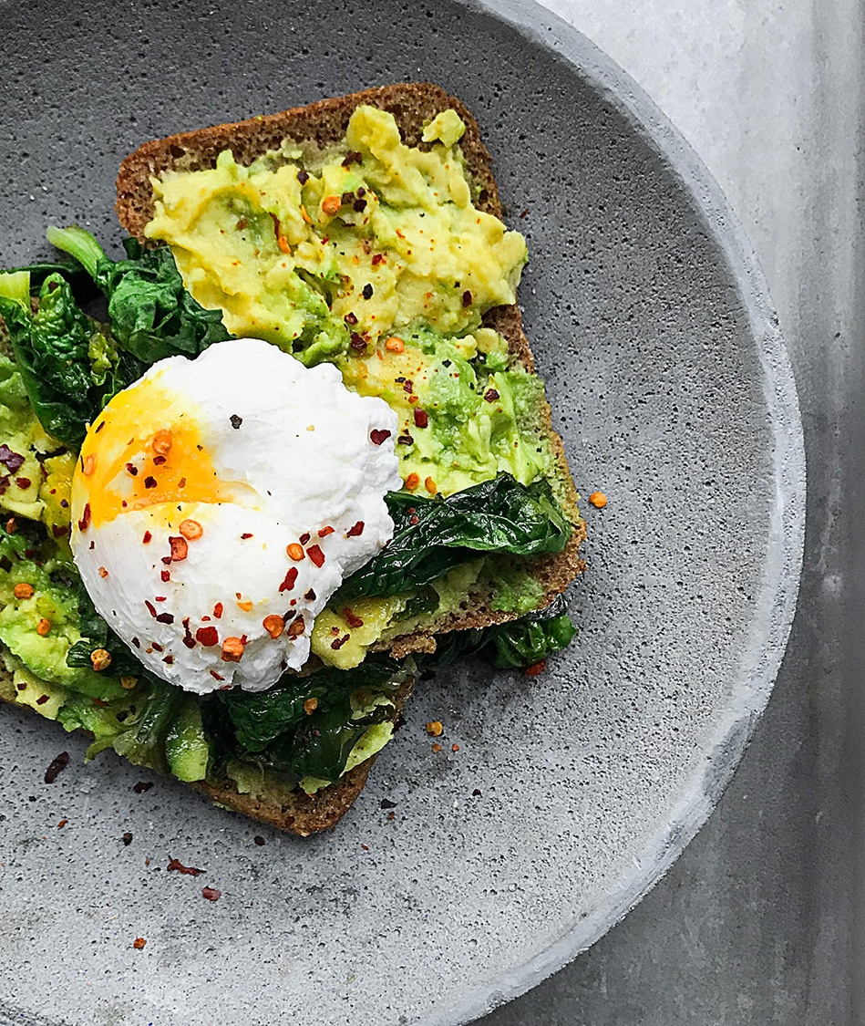
Agenda
INTRODUCTION
RELATED WORKS
SYSTEM ANALYSIS
REPORT

Slide 3
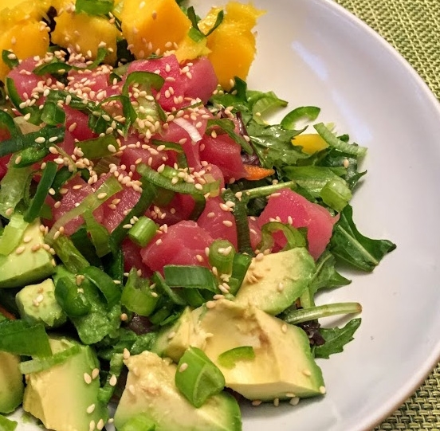
INTRODUCTION
We have created a Computer-Based Kitchen Stock Management System for the Jet-Win Light House Hotel which has a manual system. By comparison, we realized that it was a very advantageous methodology.

Slide 4

PROBLEM IN BRIEF
There are so many errors in daily transactions..
There is no way to know remaining stocks quickly.
Stock Issues clearance ,etc. need to be maintain manually in book system.
The books and the papers lose and misplace.
There are so many errors in bills. In the manual system.
Sometimes they forget to write the transactions.
No real time updates.

Slide 5

OBJECTIVES
AIM
Aim of this project is to design and develop a computer – based Kitchen Stock Management System for jet-Win Light House Hotel.
To provide stoke management subsystem for kitchen.
To compute daily transaction.
To handle inventory level of difference categories
To check the available stocks and sold-out stocks
To find most demanding items

Slide 6
RELATED WORK
Features | Manual system | Proposed system | System 01 (Amari) | System 02 (Galadari) | System 03 (Hilton) | System 04 (Capella)
 |  |  |  | Local |  | Foreign
Stock categories | No | Yes | Yes | Yes | Yes | Yes
Stock sub categories | No | Yes | No | No | No | Yes
User friendly | No | Yes | Yes | Yes | Yes | Yes
Flexibility | No | Yes | No | No | No | No
Cultural | Yes | Yes | No | No | No | Yes
Minimum cost | No | Yes | NO | No | No | No

Slide 7

SYSTEM ANALYSIS
Functional Requirements
Staff Registration
Category management
Product Management
Stock Management

Slide 8

SYSTEM ANALYSIS
Non-Functional Requirements
Requirements for performance.
Requirements for usability.
Requirements for the User Interface.

Slide 9

REFERENCE
[1] "www.Amari.com," Amari hotel, [Online]. Available: https://www.amari.com/. [Accessed 20 02 2022].
[2] "www.galadari.lk," galadari, [Online]. Available: http://www.galadarihotel.lk/. [Accessed 16 02 2022].
[3] "hilton.lk," hilton hotel, [Online]. Available: http://www.hilton.lk. [Accessed 15 02 2022].
[4] "capellahotels.com," capella hotel, [Online]. Available: https://www.capellahotels.com/. [Accessed 21 02 2022].

Slide 10


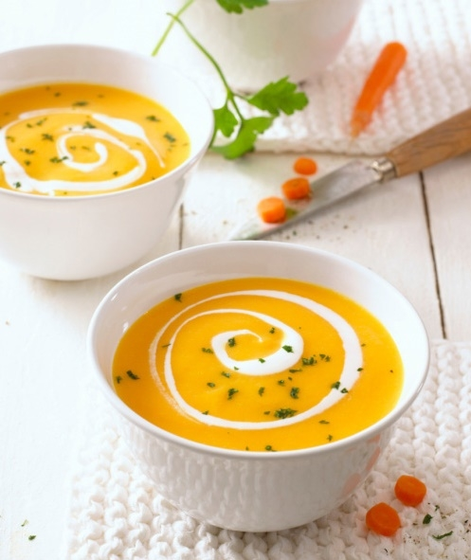
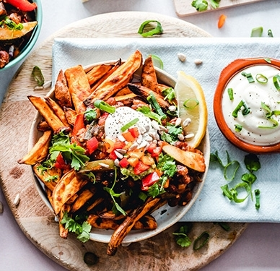
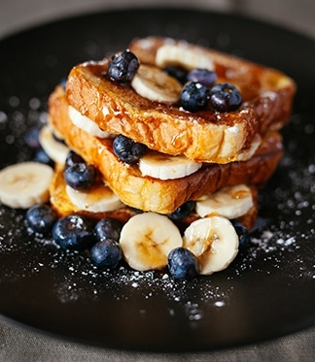

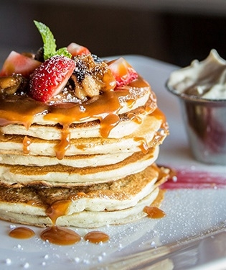
Title Here
THANK YOU.
Jayaruwan PARD
E2046035

